Slide 1
ASSIGNMENT 7 TITLE: HOME SECURITY SYSTEM
SUBMITTED BY: STEPHY BABY
(C0753812)

Slide 2
INSTALL RTOS IN KEIL SOFTWARE & TRYING FREERTOS WORKING
µVision IDE for ARM: KEIL.
System requirements for installing Keil software.
Requirements for porting FreeRTOS for LPC2148.
Creating new project in keil.
FreeRTOS porting for LPC2148.

Slide 3
µVISION IDE FOR ARM: KEIL
Keil MDK is software development environment for Arm Cortex-M based microcontrollers.
It is easy to use and supports multiple screens.
Main window consist of project, project target, manage- run time- environment and configuration wizard.
The Arm Keil Microcontroller Tools include C/C++ compilers, integrated development environments and RTOS.

Slide 4
SYSTEM REQUIREMENTS FOR INSTALLING KEIL SOFTWARE
1 GHz 32-bit or 64-bit processor.
1 GB of system memory (RAM).
2 GB of available disk space.
2 Mpbs or higher Internet connection for software activation.
32-bit and 64-bit variants of Microsoft windows are supported.

Slide 5
REQUIREMENTS FOR PORTING FREERTOS FOR LPC2148
Keil IDE for ARM.
FreeRTOS exe File.
FreeRTOSConfig.h.
Startup.s for LPC2148.

Slide 6
CREATING NEW PROJECT
1. CREATE NEW PROJECT
opened the application click the project new vision project chose the folder give filename save Selected microcontroller (LPC 2148) added Startup code to the project.
2. CREATE NEW FILE
File new code name(name.c) save

Slide 7
Cont…
3. ADDING CODE INTO THE PROJECT
Double click the source group 1 Find the code Add Editing code Save.
4. SETTING CLOCK FREQUENCY
Project Options for target target1.. Output Create HEX file Ok.
5. BUILD THE PROJECT
Project Build target.

Slide 8
FREERTOS PORTING FOR LPC2148 USING KEIL
INITIAL STEPS
Downloaded FreeRTOS exe file.
Extract FreeRTOS exe to C:\Keil
Downloaded FreeRTOSConfig.h file
Pasted FreeRTOSConfig.h file in include folder of source in FreeRTOS.

Slide 9
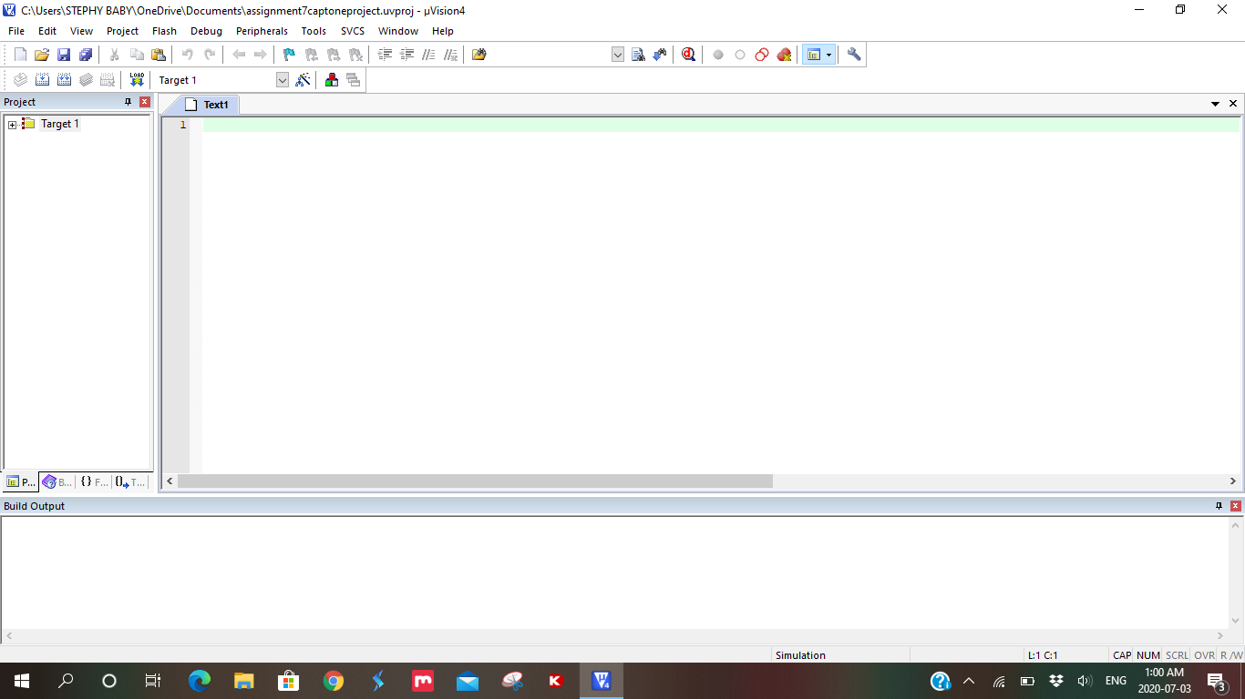
Created new project

Slide 10
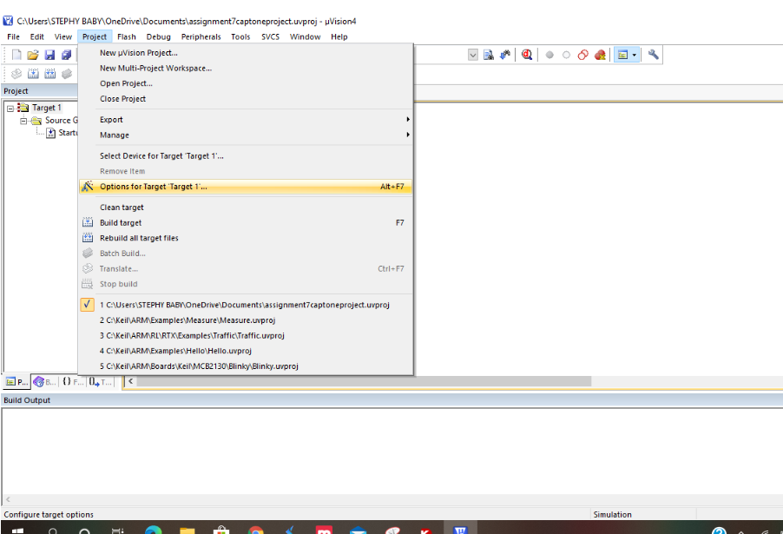
Cont…
Selected options for target
From project.

Slide 11
Cont…
Selected C/C++.
Added paths.
Added important files to the project.
Downloaded startup.s file for LPC2148.
Added the file to the project.

Slide 12
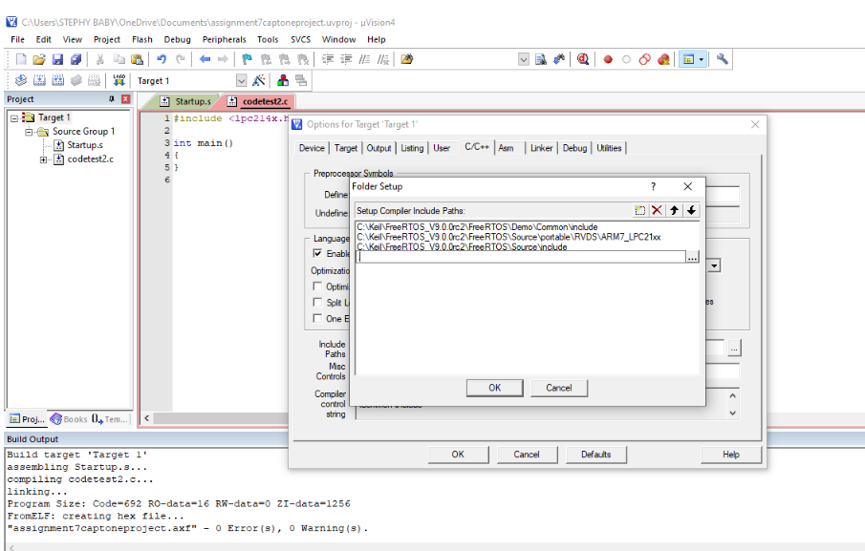

Slide 13
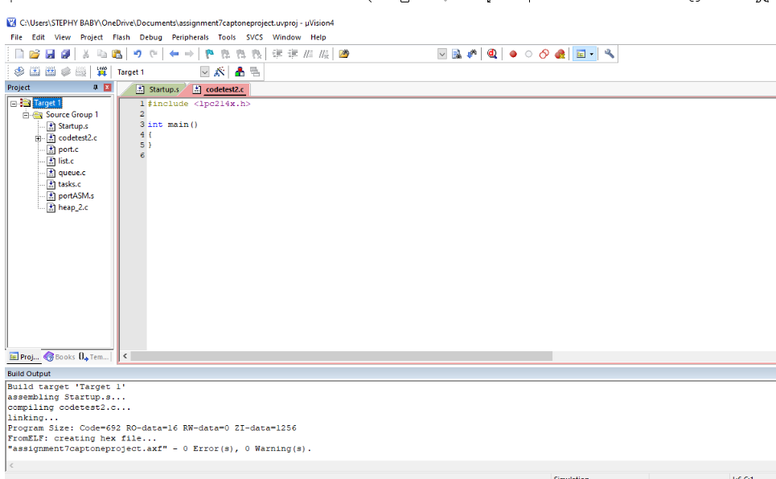

Slide 14
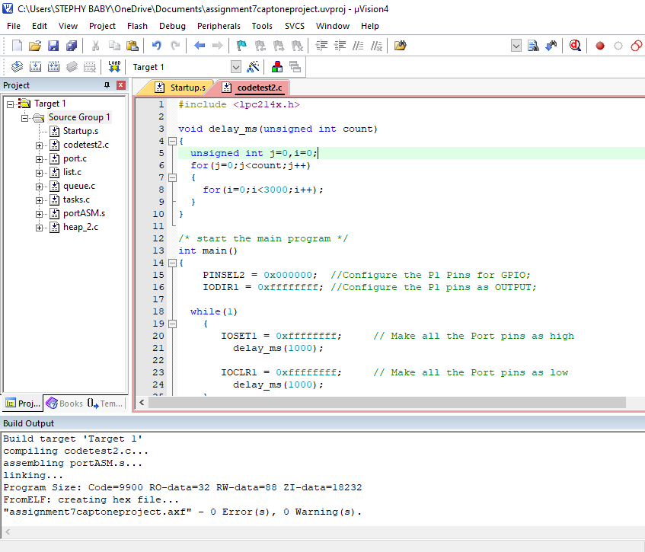
Build a sample code to shows that it
working properly.

Slide 15
REFERENCES
LPC2148 LED blinking. Tutorials. Retrieved from: https://www.exploreembedded.com/wiki/LPC2148_Led_Blinking
µVision® IDE. Retrieved from: http://www2.keil.com/mdk5/uvision/
EmbeTronicX. (November 15, 2018) FreeRTOS Porting for LPC2148 Using Keil. Retrieved from: https://embetronicx.com/tutorials/rtos/freertos/freertos-porting-for-lpc2148-using-keil/
System requirements. Arm Keil. Retrieved from: http://www2.keil.com/system-requirements/
Notes:
https://embetronicx.com/tutorials/rtos/freertos/freertos-porting-for-lpc2148-using-keil/

